Slide 1

Lecture 06:
Citing Computer Code
CoTaPP: Computational Thinking and
Programming with Python
All icons by: https://www.flaticon.com/

Slide 2

Writing Code
“Writing code is similar to academic writing in that when you use or adapt code developed by someone else as part of your project, you must cite your source.” (Academic Integrity at MIT)
https://integrity.mit.edu/handbook/writing-code#:~:text=When%20should%20I%20cite%20a,should%20still%20credit%20the%20source.

Slide 3
Writing Code
“Writing code is similar to academic writing in that when you use or adapt code developed by someone else as part of your project, you must cite your source.” (Academic Integrity at MIT)
We know that copying code/solutions from other students is wrong
https://integrity.mit.edu/handbook/writing-code#:~:text=When%20should%20I%20cite%20a,should%20still%20credit%20the%20source.

Slide 4
Writing Code
“Writing code is similar to academic writing in that when you use or adapt code developed by someone else as part of your project, you must cite your source.” (Academic Integrity at MIT)
We know that copying code/solutions from other students is wrong
But, the rules/cases for using/adapting code from other people (not peers) is not always that clear
https://integrity.mit.edu/handbook/writing-code#:~:text=When%20should%20I%20cite%20a,should%20still%20credit%20the%20source.

Slide 5
Activity
Discuss with your neighbors cases
  when is necessary to cite code
  when is NOT necessary to cite code
Write your cases in Wooclap
  next wooclap
Time: 10 min

Slide 6
Citing Code
General idea
  to some else, it should be clear what is your original contribution and what is based on other people’s contributions

Slide 7
Rule of thumb
Don’t cite:
  General patterns: if there is only one way to program a specific task and this is so commonly used then it may not need to be cited
    E.g., a "hello world" program, create a new window, read a column using Pandas, creating a infinite loop, etc.
https://integrity.mit.edu/handbook/writing-code#:~:text=When%20should%20I%20cite%20a,should%20still%20credit%20the%20source.

Slide 8
Rule of thumb
Don’t cite:
  General patterns: if there is only one way to program a specific task and this is so commonly used then it may not need to be cited
    E.g., a "hello world" program, create a new window, read a column using Pandas, creating a infinite loop, etc.
Cite:
  when copy code from an external source
  when copy the code and adapt it
https://integrity.mit.edu/handbook/writing-code#:~:text=When%20should%20I%20cite%20a,should%20still%20credit%20the%20source.

Slide 9
Rule of thumb
Don’t cite:
  General patterns: if there is only one way to program a specific task and this is so commonly used then it may not need to be cited
    E.g., a "hello world" program, create a new window, read a column using Pandas, creating a infinite loop, etc.
Cite:
  when copy code from an external source
  when copy the code and adapt it
Follow the license. If there is no license, assume it has copyright
https://integrity.mit.edu/handbook/writing-code#:~:text=When%20should%20I%20cite%20a,should%20still%20credit%20the%20source.

Slide 10
Example (appropriate)
/**
* A utility class that gives applets the ability to detect proxy host settings.
* This was adapted from a post from Chris Forster on 20030227 to a Sun Java
* forum here:
* http://forum.java.sun.com/thread.jspa?threadID=364342&tstart=120
*/
<CODE>
Source: https://integrity.mit.edu/handbook/writing-code#:~:text=When%20should%20I%20cite%20a,should%20still%20credit%20the%20source.

Slide 11
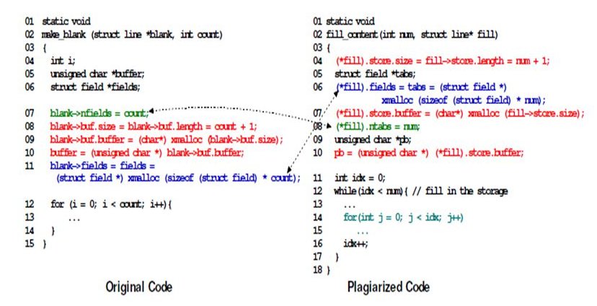
Example (inappropriate)
Source: https://codequiry.com/code-plagiarism#:~:text=Some%20Examples%20Of%20Code%20Plagiarism&text=This%20is%20when%20a%20student,common%20trend%20in%20the%20classroom.

Slide 12
Citing Code: Resources
https://lib.pstcc.edu/csplagiarism/citation
https://integrity.mit.edu/handbook/writing-code#:~:text=When%20should%20I%20cite%20a,should%20still%20credit%20the%20source.

Slide 13
Can I use external code if I cite it?
https://integrity.mit.edu/handbook/writing-code#:~:text=When%20should%20I%20cite%20a,should%20still%20credit%20the%20source.

Slide 14
Purpose of evaluation
Evaluations/Assignments want to measure your:
  Knowledge
  Creativity
  Capacity to solve a problem
  Etc.
If you copy a solution from Stack Overflow/Generative AI:
  We are not evaluating your knowledge, creativity, capacity, etc.
  We are evaluating your ability to use those tools and their accuracy.
https://integrity.mit.edu/handbook/writing-code#:~:text=When%20should%20I%20cite%20a,should%20still%20credit%20the%20source.

Slide 15
Can I use external code if I cite it?
If you find a code/solution for something that is not what is being evaluated:
  External sources could be used (if cited):
    “you need to do all the implementation by yourself”
    “you cannot use external libraries for the calculations …”
    “you can use any library/solution for the display of reports”
  Better to ask
https://integrity.mit.edu/handbook/writing-code#:~:text=When%20should%20I%20cite%20a,should%20still%20credit%20the%20source.

Slide 16
Lecture 6:
Functions, Modules, Libraries, Packages
CoTaPP: Computational Thinking and
Programming with Python
All icons by: https://www.flaticon.com/

Slide 17
Previous lecture
Loops (repetitive behavior):
  while
  for
  break
  continue
Post-test loops in Python

Slide 18



Slide 19
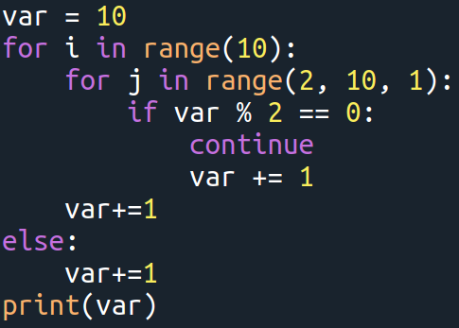
What is the value of the var after the for loop completes its execution?
Solution: 21

Slide 20
Today’s lecture
Functions, modules and packages
  functions allow you to reuse already existing functionality (rather than implementing it again)
  modules and packages allows you to logically organize your Python code
Recursion
  A method of solving a computational problem where the solution depends on solutions to smaller instances of the same problem

Slide 21


Slide 23
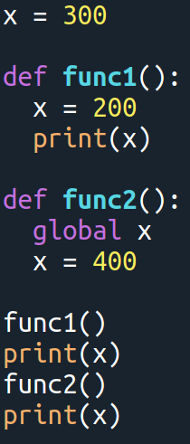
Which values are printed?
Solution: 200, 300, 400

Slide 24
To Do
Exercises for the week
  Use quarterfall to submit them
Work in Project 1 (just a few more days)
StudyLens

Slide 25
Next lecture
Data structures in Python
  more powerful data items than just the individual values

Slide 26

Next lecture
Data structures in Python
  more powerful data items than just the individual values

Slide 27
Next lecture
Recursion
  a method of solving a computational problem where the solution depends on solutions to smaller instances of the same problem

Slide 28
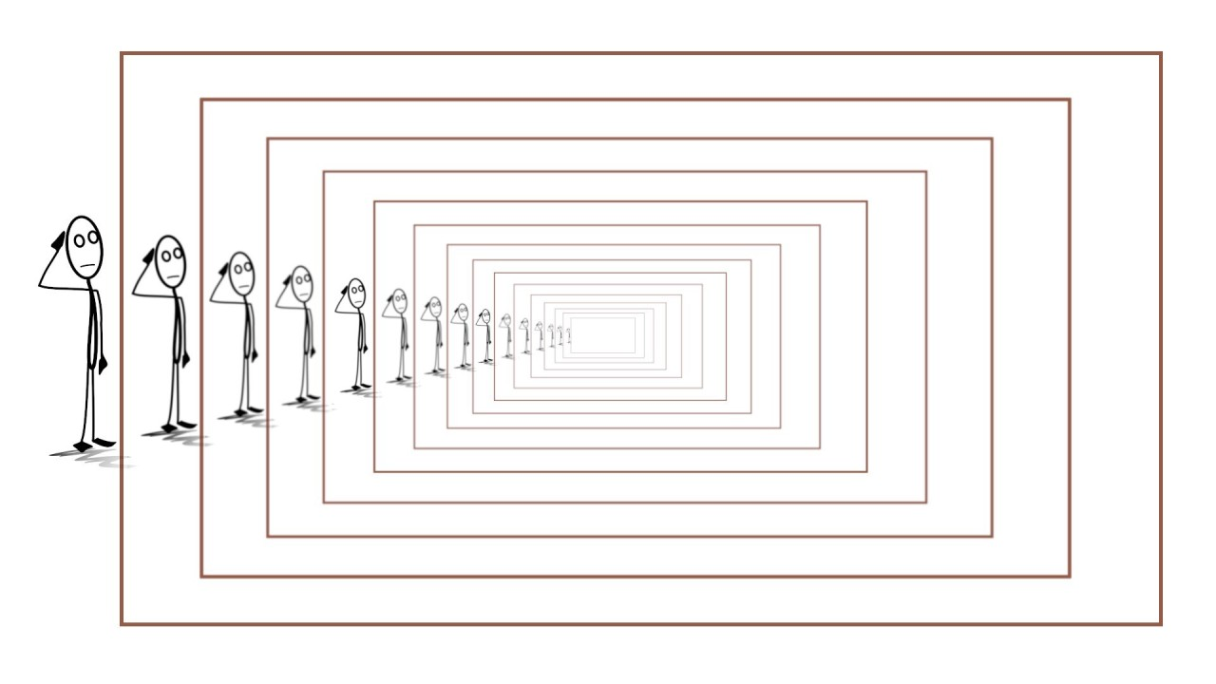
Next lecture
Recursion
  a method of solving a computational problem where the solution depends on solutions to smaller instances of the same problem
  “In order to understand recursion, one must first understand recursion.”

